Slide 1


Mastering PivotTable Dashboards & Reports

Slide 2
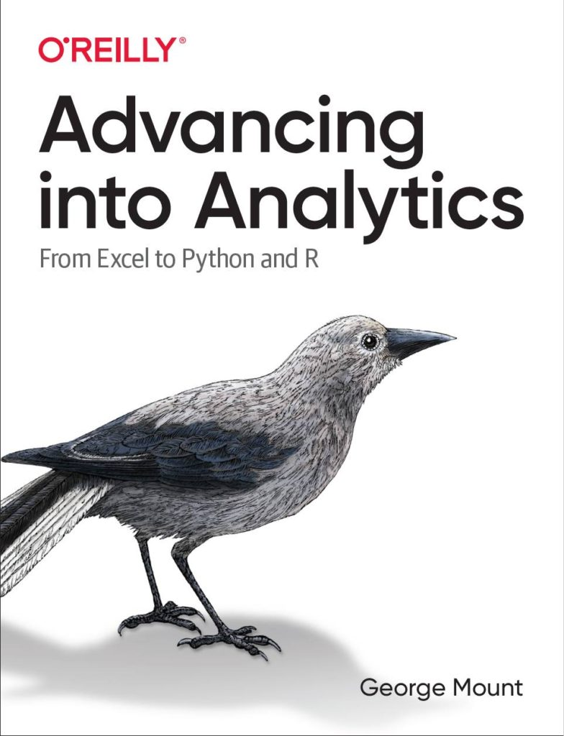


Hi, I’m George

Slide 3

Objectives for this session
Use Pivot Tables to generate summary data, reports, and dashboards in seconds
Create connections across data with the Excel Data Model
Visualize data across multiple tabs

Slide 4
Following along
Each section is a workbook
Solutions in separate workbooks
Follow along with demo notes

Slide 5
1. PivotTables: The WD-40 of Excel

Slide 6

Every PivotTable operation is one of these…
Slice and dice
Drill down/roll up
Pivot/Unpivot
Notes:
Don’t worry too much about the building blocks right now – I have this in here to gauge everyone’s interest

Slide 7
Demo
Using the tips worksheet:
Get the total bill by day, then time
Get the total bill for smokers only on Saturday and Sunday
Get average tips by day for each group size
Notes:
This would be rolling up and drilling down
This is slicing and dicing
This is unpivoting and pivoting

Slide 8
Demo
Using wholesale-customers worksheet:
Get the total sum of sales by Region, then Channel
Notes:
Doesn’t work so well, right?

Slide 9
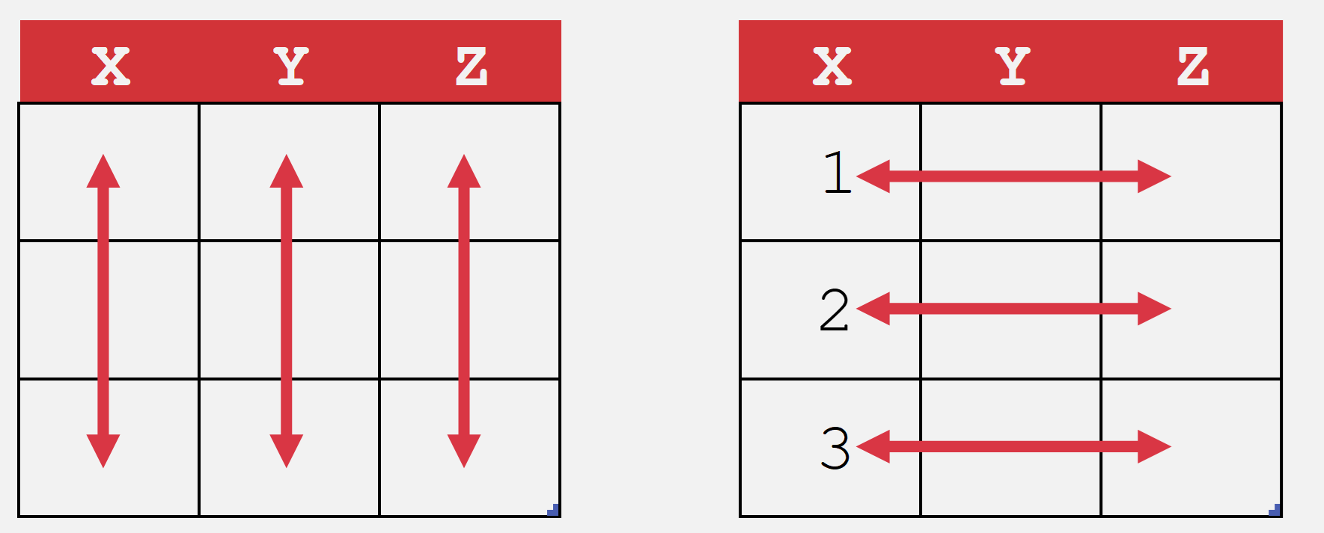
What makes data “Pivot”-ready?
Each variable is in its own column
Each observation is in its own row
Every cell is an observation-variable intersection
Notes:
The Power Query course will be good to actually shape this data. /

Slide 10
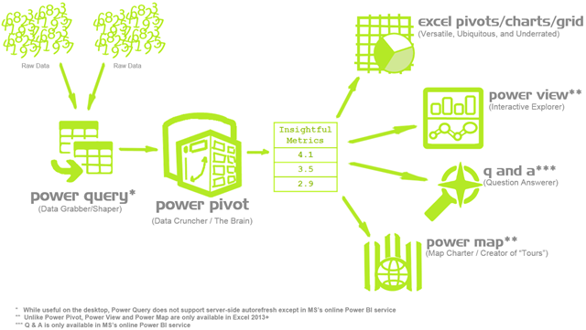
Heavy cleaning is a job for Power Query
https://p3adaptive.com/2014/09/what-is-power-bi/
Notes:
Don’t worry too much about the building blocks right now – I have this in here to gauge everyone’s interest

Slide 11
2. PivotCharts and visualizations

Slide 12
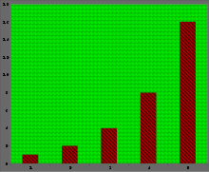
How can we master PivotCharts?
Pros: Pivot + Charts
Cons: Chartjunk
“The purpose of decoration varies—to make the graphic appear more scientific and precise, to enliven the display, to give the designer an opportunity to exercise artistic skills. Regardless of its cause, it is all non-data-ink or redundant data-ink, and it is often chartjunk.” --Edward Tufte
https://en.wikipedia.org/wiki/Chartjunk
Notes:
The Power Query course will be good to actually shape this data. /

Slide 13
Demo
computers worksheet:
Compare the distribution of
Notes:
Doesn’t work so well, right?

Slide 14
Exercises
tips worksheet:
Visualize the distribution of tips for lunch vs dinner bills as overlapping histograms
Create a stacked bar chart comparing total dinner vs lunch bills for each day of service
Notes:
Doesn’t work so well, right?

Slide 15
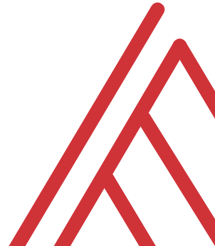
Questions?

Slide 16
Introduction to Excel dashboards

Slide 17
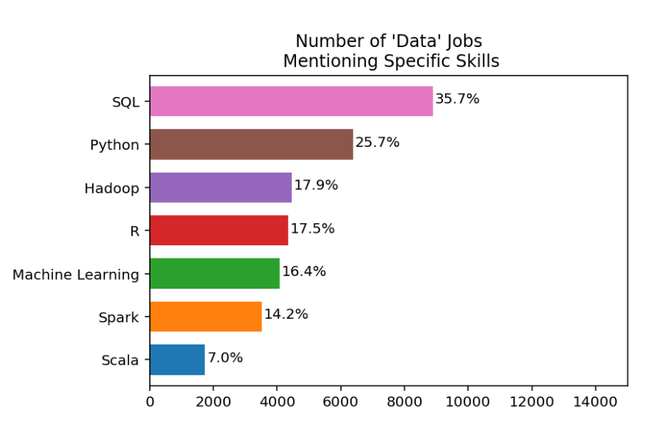
I’m guessing you want work
https://www.dataquest.io/blog/why-sql-is-the-most-important-language-to-learn/

Slide 18

Cross-train your data brain

Slide 19
What is a spreadsheet and when would you use it?
Good for…
Browsing data
Entering/editing data
Flexible data structuring
Quick, visual data analysis on small datasets
Not so much at…
Archiving data
Big data
Interfacing data
Structured data across multiple datasets

Slide 20






Relational databases
1970s origins…
Still with us today!

Slide 21

Meet your librarian
Structured
Query
Language

Slide 22

Are you ready for some baseball?
Lahman database: complete player statistics since 1871 plus salaries, Hall of Fame inductions and more!
Download here for SQLite

Slide 23

Onward to SQLite!
+

Slide 24
ARE YOU READY FOR SOME DRILLS?
How many columns are in Managers?
How many of these columns are of type INTEGER?
How many rows does Managers have?

Slide 25
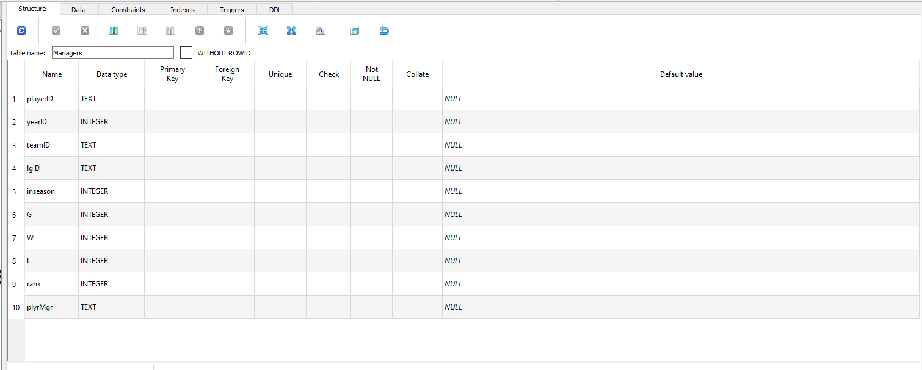
How many columns are in Managers?

Slide 26
2. How many of these columns are of type INTEGER?

Slide 27
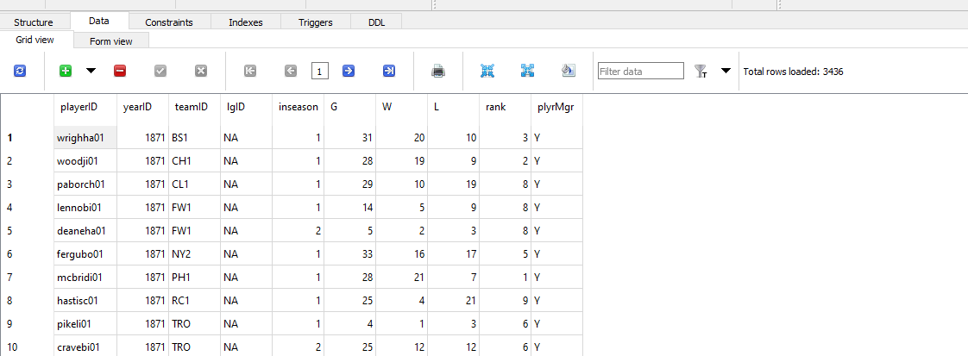
3. How many rows does Managers have?

Slide 28
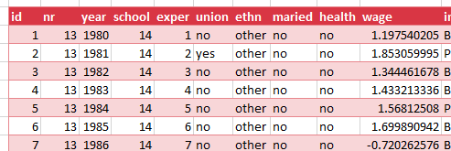
Look to the table
Field/column/attribute
Row/tuple
Value
Table

Slide 29
Questions?

Slide 30
From Excel tables to SQL SELECT

Slide 31
From Excel-ese to SQL-ese
Excel
Data
Calculations
Notes
SQL
Tables
Queries/Scripts
Comments

Slide 32
The grammar of SQL
Term | What it does | Example
Identifier | Identifies an object (i.e. table, field) | Master
Operator | Takes some action (perform calculation,, rename something) | +, AS
Expression | Applies criteria to data | birthYear > 1960

Slide 33

Stylin’ in SQL
0. Good comments starting with –
Each clause on its own line
All operators uppercase (SELECT, ORDER BY, etc.)
Statements end with semicolon (;)

Slide 34
Let’s get coding…
-- List all the tables in our database
SELECT name
FROM sqlite_master
WHERE type='table'
ORDER BY name;
--Get the name and data type from every field in the
--"master" table
PRAGMA table_info(master);

Slide 35
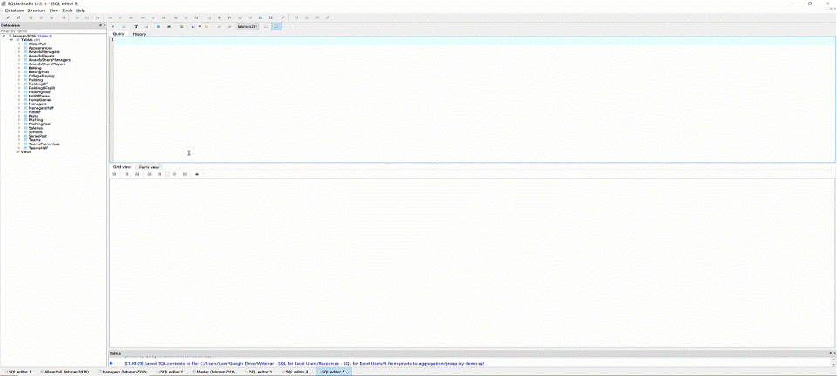
The font is too dang small!

Slide 36
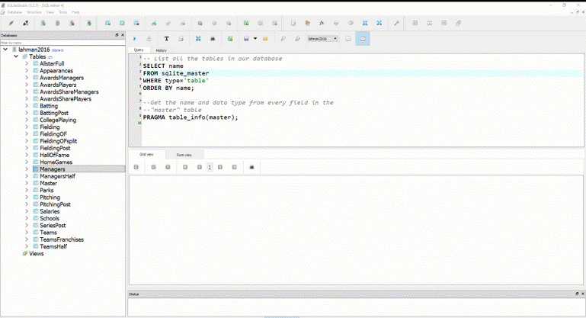
Saving your first .sql script

Slide 37
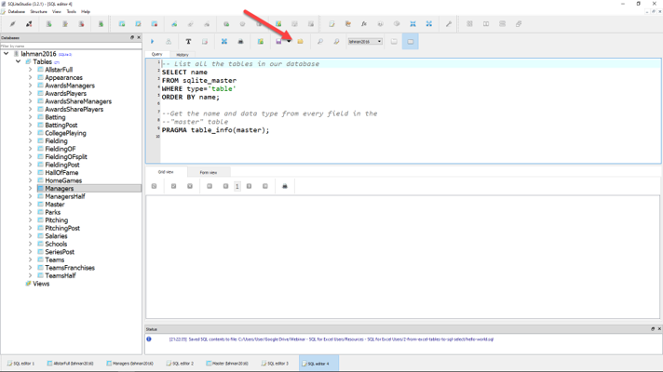
Loading your first .sql script

Slide 38
Demo: sql-tables-example.xlsx

Slide 39
The SQL reader’s digest
Term | What it does
SELECT | Which fields to look for
FROM | Where to look for those fields
WHERE | What criteria those records should meet
GROUP BY | How to aggregate the results
HAVING | What criteria the aggregated results should meet
ORDER BY | How to sort the results
LIMIT | How many records to limit results to

Slide 40
Demo: sql-select-demo.sql

Slide 41
Drills
Using the Teams table:
Select all fields.
Select all fields, first 100 rows.
Select yearID, teamID, W, L.
Select yearID, teamID, and a calculated field win_diff as the difference between W and L.
Create a field team_record such that the first record will read: 1871 Boston Red Stockings: 20-10.

Slide 42
Drills
Using the Teams table:
Select all fields.
Select all fields, first 100 rows.
Select yearID, teamID, W, L.
Select yearID, teamID, and a calculated field win_diff as the difference between W and L.
Create a field team_record such that the first record will read: 1871 Boston Red Stockings: 20-10.
Solutions: sql-select-drills.sql

Slide 43
From Sort & Filter to WHERE and ORDER BY

Slide 44
Demo: sort-filter.xlsx

Slide 45
The SQL reader’s digest
Term | What it does
SELECT | Which fields to look for
FROM | Where to look for those fields
WHERE | What criteria those records should meet
GROUP BY | How to aggregate the results
HAVING | What criteria the aggregated results should meet
ORDER BY | How to sort the results
LIMIT | How many records to limit results to

Slide 46
WHERE: Comparison operators
Operator | Description
= | Equal to
<>, != | Not equal to
> | Greater than
< | Less than
>= | Greater than or equal to
<= | Less than or equal to

Slide 47
WHERE: Logical operators
Operator | Description
BETWEEN | Between an inclusive range
IS NULL | Is a null value
IN | Specifies a range of conditions
OR | Avoids evaluating second condition if first is met
AND | Can be used with other operators
NOT | Excludes results

Slide 48
WHERE LIKE: Wildcard operators
Operator | Description
‘a%’, ‘abc%’ | Returns records that start with a, abc
‘_ _ a’,’_ _ c’ | Returns records with a in 2nd position, abc in 3rd position

Slide 49

A note on NULLs
DOES
Indicate a missing value
DOES NOT
Indicate a value of 0
Indicate why it’s missing

Slide 50
Demo: sort-filter-demo.sql

Slide 51
Drills (continues on next slide)
Using the Managers table:
Select all records, sorted newest to oldest, then by playerID alphabetically.
Select all records between the 1991 and 2000 seasons, sorted high to low by number of games, G.
Create a field, win_diff, calculated as W – L. Return the records with the 25 highest values of win_diff.
How many missing values are in the rank field?

Slide 52
Drills (continued from previous slide)
Using the Managers table:
Select all records, sorted newest to oldest, then by playerID alphabetically.
Select all records between the 1991 and 2000 seasons, sorted high to low by number of games, G.
Create a field, win_diff, calculated as W – L. Return the records with the 25 highest values of win_diff.
How many missing values are in the rank field?

Slide 53
From SUM() and SUMIF() to Aggregation

Slide 54
Demo: aggregation-demo.xlsx

Slide 55
Basic arithmetic functions
Operator | Description
SUM() | Total of records
AVG() | Average of records
MIN() | Minimum value of records
MAX() | Maximum value of records
COUNT() | Count of non-null records

Slide 56
Basic string functions
Operator | Description
CONCAT() | Concatenates fields together
LEFT() | Returns left X values from a string
RIGHT() | Returns right X values from a string
UPPER() | Returns capitalized string
LOWER() | Returns lowercased string

Slide 57
Exploring fields and records
Operator | Description
COUNT(X) | Counts all non-null records of X
DISTINCT X | Returns all distinct values of X
COUNT(DISTINCT X) | Counts distinct values of X

Slide 58
Demo: aggregation-demo.sql

Slide 59
Drills (continues on next slide)
Using the Teams table:
Select the maximum and minimum number of runs.
Select the total number of home runs between 2000 and 2010: total_homers.
Count the number of records where the games played is NULL.
Count the number of records with a recorded attendance.
Return a list of all years reflected in the table.
Count the number of unique franchises since 1915.

Slide 60
Drills (continues on next slide)
Using the Teams table:
Select the maximum and minimum number of runs.
Select the total number of home runs between 2000 and 2010: total_homers.
Count the number of records where the games played is NULL.
Count the number of records with a recorded attendance.
Return a list of all years reflected in the table.
Count the number of unique franchises since 1915.
Solutions: aggregation-drills.sql

Slide 61
From PivotTables to GROUP BY

Slide 62
Demo: group-by-demo.xlsx

Slide 63
The SQL reader’s digest
Term | What it does
SELECT | Which fields to look for
FROM | Where to look for those fields
WHERE | What criteria those records should meet
GROUP BY | How to aggregate the results
HAVING | What criteria the aggregated results should meet
ORDER BY | How to sort the results
LIMIT | How many records to limit results to

Slide 64
Demo: group-by-demo.sql

Slide 65
Drills
Using the Teams table:
Return the largest attendance for each team, sorted high to low.
Find the total number of stolen bases, grouped by year and league.
Find the average number of home runs for each season, keeping only years with an average of 150 home runs or more.

Slide 66
Drills
Using the Teams table:
Return the largest attendance for each team, sorted high to low.
Find the total number of stolen bases, grouped by year and league.
Find the average number of home runs for each season, keeping only years with an average of 150 home runs or more.
Solutions: group-by-drills.sql

Slide 67
Capstone: All clauses in one

Slide 68
The SQL reader’s digest
Term | What it does
SELECT | Which fields to look for
FROM | Where to look for those fields
WHERE | What criteria those records should meet
GROUP BY | How to aggregate the results
HAVING | What criteria the aggregated results should meet
ORDER BY | How to sort the results
LIMIT | How many records to limit results to

Slide 69


Try forgetting now…
Term | What it does
SWEATY | SELECT
FEET | FROM
WILL | WHERE
GIVE | GROUP BY
HORRIBLE | HAVING
ODORS | ORDER BY

Slide 70
Try forgetting now…
Term | What it does
SWEATY | SELECT nameFirst, COUNT(nameFirst)
FEET | FROM Master
WILL | WHERE birthCountry != ‘USA’
GIVE | GROUP BY nameFirst
HORRIBLE | HAVING COUNT(nameFirst) > 1
ODORS | ORDER BY COUNT(nameFirst) DESC;

Slide 71
Drills
Using the Teams table:
Find the maximum number of home runs hit by a team for each year since 1980. Include only those years where fewer than 200 home runs were hit by any team. Sort the results from high to low.
For NL teams that won the World Series that year, what was the maximum number of games won? Include only those teams that won at least 100 games for one of those years. Sort the results from high to low.

Slide 72
Drills
Using the Teams table:
Find the maximum number of home runs hit by a team for each year since 1980. Include only those years where fewer than 200 home runs were hit by any team. Sort the results from high to low.
For NL teams that won the World Series that year, what was the maximum number of games won? Include only those teams that won at least 100 games for one of those years. Sort the results from high to low.
Solutions: sql-all-statements-in-one-drill.sql

Slide 73
From VLOOKUP() to JOIN

Slide 74

How do we get information from more than one table at a time?
What makes a relational database, relational?
https://dev.to/helenanders26/sql-series-all-about-sql-joins-15ol

Slide 75
Demo: vlookup-vs-join.xlsx

Slide 76
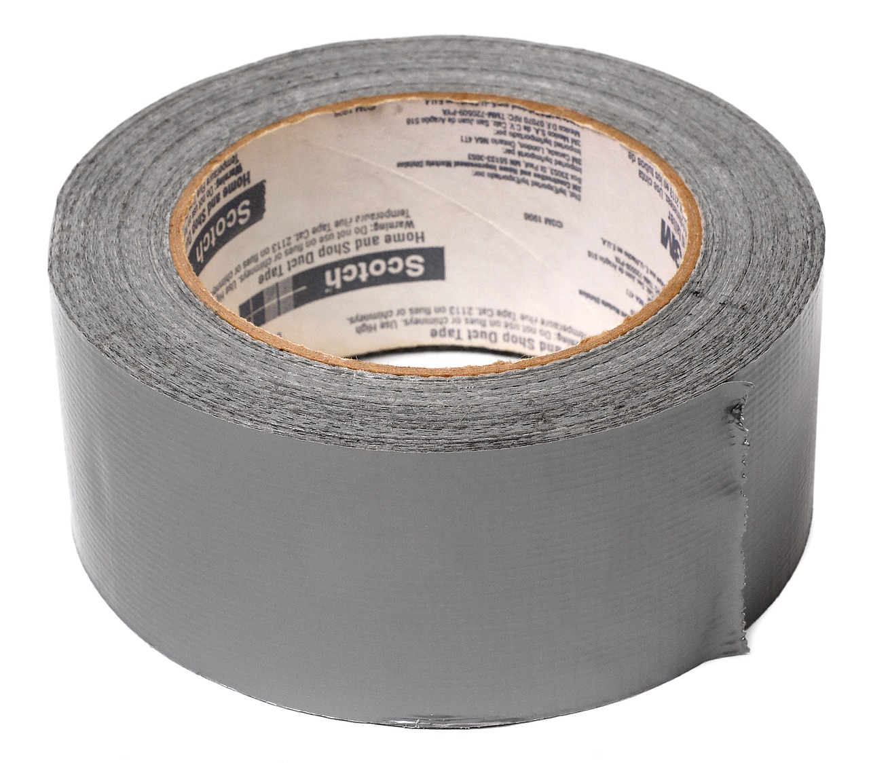

FROM VLOOKUP() Duct Tape to JOIN Blowtorch

Slide 77

Key-lookup
Primary key: Unique, unchanging identifier
Foreign key: References the primary key of another table

Slide 78

Ever been asked for your ID number?
That’s your primary key!

Slide 79
One-to-one relationship

Slide 80
One-to-many relationship

Slide 81
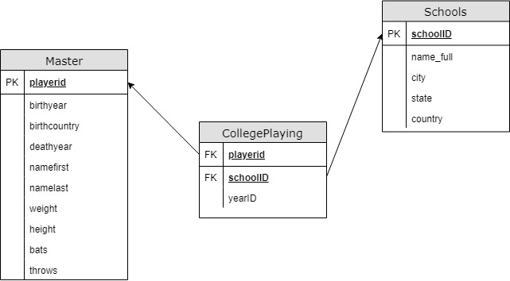
Introducing Schemas

Slide 82
INNER JOIN
Returns records with matching values in both Table A and Table B
TABLE A
TABLE B

Slide 83
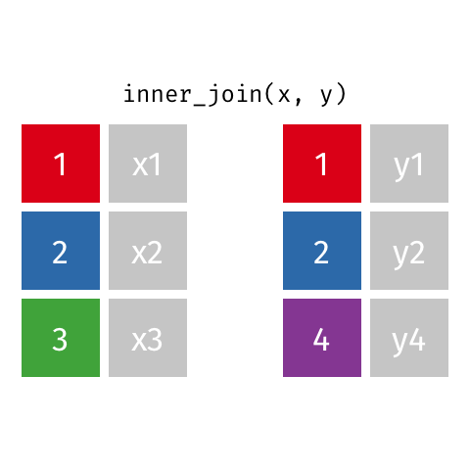
Visualizing an INNER JOIN
https://github.com/gadenbuie/tidyexplain#mutating-joins

Slide 84
Demo: inner-join-demo.sql

Slide 85
Drills
For the Master and HallOfFame tables:
Return a list of unique first and last names for all individuals in HallOfFame
Return first and last names along with the year, votes needed and votes received for all successful HoF inductees
Return the birth year of the oldest individual inducted for each year of HoF inductions. How “old” was each player at induction?

Slide 86
Drills
For the Master and HallOfFame tables:
Return a list of unique first and last names for all individuals in HallOfFame
Return first and last names along with the year, votes needed and votes received for all successful HoF inductees
Return the birth year of the oldest individual inducted for each year of HoF inductions. How “old” was each player at induction?
Solutions: inner-join-drills.sql

Slide 87
LEFT OUTER JOIN
Returns all records from Table A and matching records from Table B. NULL if no match.
TABLE A
TABLE B

Slide 88

Visualizing a LEFT OUTER JOIN
https://github.com/gadenbuie/tidyexplain#mutating-joins

Slide 89
Demo: left-outer-join-demo.sql

Slide 90
Drills
Find the maximum annual salary paid to anyone included in Master, sorted descending by salary.
Keeping the names of all schools listed in Schools, find the first name, last name and years played for all schools (Check CollegePlaying).

Slide 91
Drills
Find the maximum annual salary paid to anyone included in Master, sorted descending by salary.
Keeping the names of all schools listed in Schools, find the first name, last name and years played for all schools (Check CollegePlaying).
Solutions: left-outer-join-drills.sql

Slide 92
From “That’s hard in Excel!” to “That’s easy in SQL!”

Slide 93
Demo: hard-in-excel-easy-in-sql.xlsx

Slide 94
Demo: hard-in-excel-easy-in-sql.sql

Slide 95
CASE expressions
CASE
WHEN condition THEN result-expression
WHEN condition THEN result-expression ...
ELSE result-expression
END AS alias

Slide 96
Subqueries as condition: WHERE
SELECT fields
FROM table
WHERE operator
-- Subquery
(SELECT fields
FROM table);

Slide 97
Common table expressions (CTEs): Expressions acting like tables
WITH
expression_name_1 AS
(CTE query definition 1)
SELECT expression_A, expression_B, ...
FROM expression_name_1

Slide 98
Drills
Using the Teams table:
In 2016, what teams had more wins than the Chicago Cubs (teamID = ‘CHN’?)
Create a field Century which marks records in the 19th Century as 19, 20th as 20 and 21st as 21.
Find the average season minimum attendance since 1990.

Slide 99
Drills
Find the maximum annual salary paid to anyone included in Master, sorted descending by salary.
Keeping the names of all schools listed in Schools, find the first name, last name and years played for all schools (Check CollegePlaying).
Solutions: hard-in-excel-easy-in-sql.sql

Slide 100
SQL: The Prequel

Slide 101

Learning SQL, 2nd Edition
by Alan Beaulieu

Slide 102

SQL Cookbook
By Anthony Molinaro

Slide 103
Find me
georgejmount.com
@gjmount
github.com/summerofgeorge

Slide 104
Thank you

